Slide 1
Substation and Distribution Automation
Module 1: Introduction and Evolution of Electric Distribution Systems

Slide 2
Module 1 Overview
Part 1: History of electrical distribution in North America
Part 2: Distribution system design characteristics
Part 3: Operational and planning considerations
Part 4: Simulation and analysis

Slide 3
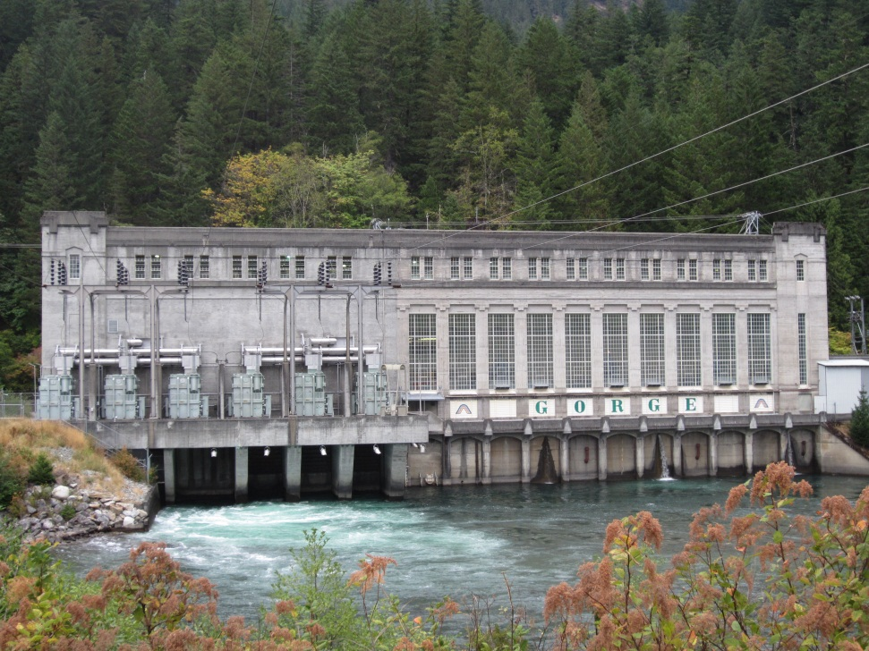
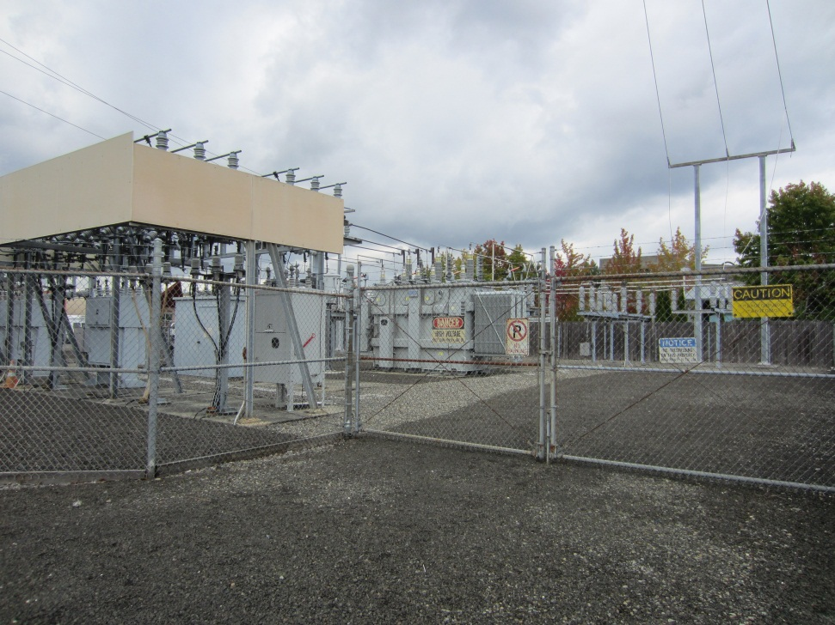
Part 1: History of Electrical Distribution in North America

Slide 4
Significant Technical Milestones
1800: First electric battery (Alessandro Volta)
Zinc and copper (rechargeable lead acid was not until 1859)
A wet cell design using brine
1821: Invention of the electric motor and generator (Michael Faraday)
1832: Invention of the dynamo (Hippolyte Pixii)
1879: Invention of incandescent lamp (Joseph Swan)
1882: Pearl Street Station began operation (85 customers)
400 lamps/85 customers
175 horse power (130.5 kilowatts)
1881: Invention of the transformer
1886: Great Barrington MA 1 kV AC distribution system (William Stanley)
Single phase (500V generation, 3,000V distribution, 100V end-use)
500 kW peak output
1888: Invention of Polyphase AC system (Nikola Tesla)
1891: Willamette Falls generating station began operation
200 horsepower, 2 phase, (65 kilowatts)
Transmitted power the 14 miles to Portland Or at 3,300 Volts
1896: Niagara Falls generating station began operation
Three 5,000 horsepower, 2 phase, 25 Hz, generators (3.7 MW each)
Transmitted power the 22 miles to Buffalo NY at 11,000 Volts

Slide 5
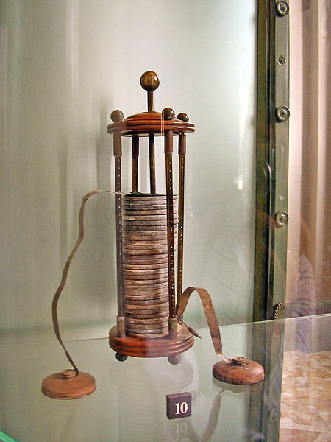
First Electric Battery
Alessandro Giuseppe Antonio Anastasio Volta (1745-1827): The Italian physicists who is credited with inventing the modern electrochemical cell.
The voltaic pile was composed of Zinc (Zn) and Copper (Cu) in a sulfuric acid solution (H₂SO₄).
Unlike the previously known Leyden jar, Voltas electrochemical cell could maintain a current for a prolonged period of time.
As the cell is discharged hydrogen plates on the zinc electrode and cannot be removed by charging the battery.
The ability to supply a continuous current laid the foundation for using electricity in non-laboratory environment.

Slide 6
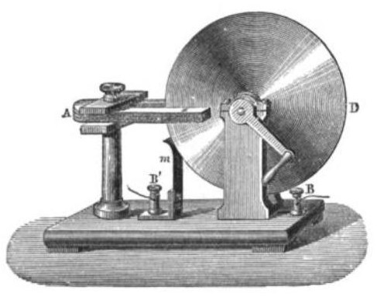
Invention of Electric Motor and Generator
Michael Faraday (1791-1867): An English chemist and physicist who is credited with some of the first operational motors and generators.
Faraday’s Law bears his name.
The first electromagnetic generator was called a “Faraday Disk” and produced a DC current.
The Faraday Disk was extremely inefficient and could not be used to generate significant amount of electricity.
The ability to continually produce electricity via a prime mover proved the concept of transferring mechanical energy into electrical energy.

Slide 7
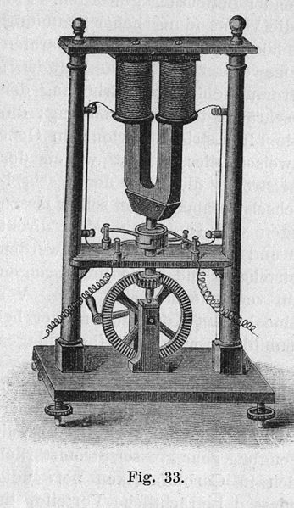
Invention of the Dynamo
Hippolyte Pixii (1808-1835): A French instrument maker credited with the invention of the Dynamo.
The dynamo would spin a permanent magnet which would induce a voltage in fixed coils.
A commutator assembly was used to produce a pulsed DC output.
Unlike the Faraday Disk the Dynamo was able to produce a large amount of electric current.
Despite the relatively large DC output, it was a pulsed output because of the basic commutator design.
The dynamo was the first practical generator that could be used to supply usable electricity.

Slide 8
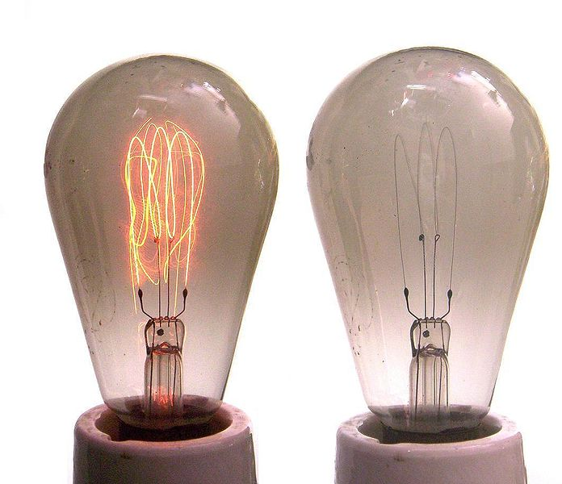
Invention of the Incandescent Lamp
Joseph Swan (1828-1914): A British physicist and chemist who is credited with the invention of the incandescent light bulb.
The first patent was awarded in 1878.
While Thomas Edison is often thought of as the inventor of the light bulb, he was simply better at advertising his ideas.
Lighting became the first electrical load for electric utilities because it could be used by almost anyone.

Slide 9
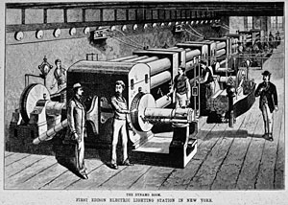
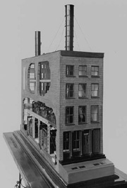
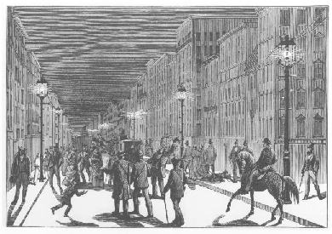
Pearl Street Station Begins Operation
Started operation on 9/4/1882
1 coal powered DC Generator (Dynamo)
175 horse power (130.5 kilowatts)
400 lamps/85 customers
The Pearl Street Station was the first central power plant in North America, containing generators, distribution, and load.
The Pearl Street Station established the template for early DC generation and distribution systems.
Because of the low distribution voltage power could only be supplied within a radius of a mile or two.
With DC there is only a single voltage supplied while loads may require different voltages.

Slide 10
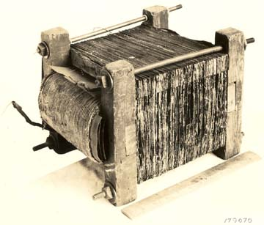
Invention of the Transformer
Early transformers (circa 1883) were used in conjunction with switching circuits to increase the voltage output of batteries. They were not able to handle large amounts of power.
William Stanly (1858-1916): an American physicist who is credited with the first practical power transformer in 1885.
This transformer was based on the earlier work of Lucien Gaulard and John Gibbs.
Transformers allowed for a complete AC system with generators, distribution, and end-use loads with various voltages.
Picture from Edison Tech Center: http://www.edisontechcenter.org/WilliamStanley.html

Slide 11
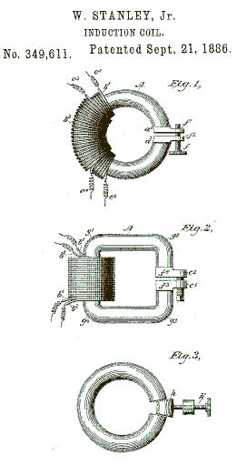
The First AC Distribution System Begins Operation
1886: William Stanley constructs the first complete single phase AC power system in Great Barrington MA.
A local rubber mill was used as the 500 kW power house to generate electricity at 500V.
Voltage was stepped up to 3,000V for transmission into town.
Voltage was stepped down to 100V for use by end use customers.

Slide 12
Invention of the Polyphase AC System
Nikola Tesla (1856-1943): Austrian mechanical and electrical engineer credited with the invention of the Polyphase AC system.
The Polyphase systems allowed for higher voltages because of the line to line structure.
The Polyphase system allowed for more efficient electrical machine designed, specifically generators and motors.
While higher order phases have been examined, the three phase system has become standard.

Slide 13
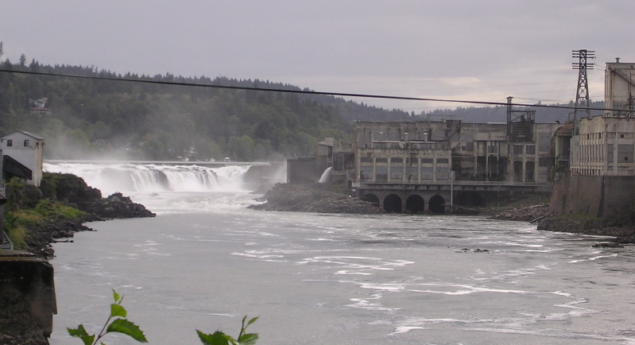
Willamette Falls Generation Station Begins Operation
1891: Willamette Falls generating station began operation.
200 horsepower (65 kilowatts), 2 phase system.
Transmitted power the 14 miles to Portland OR at 3,300 Volts.
This was the first operating Polyphase system and is the model for modern systems.
The original generating station is still in operation.

Slide 14
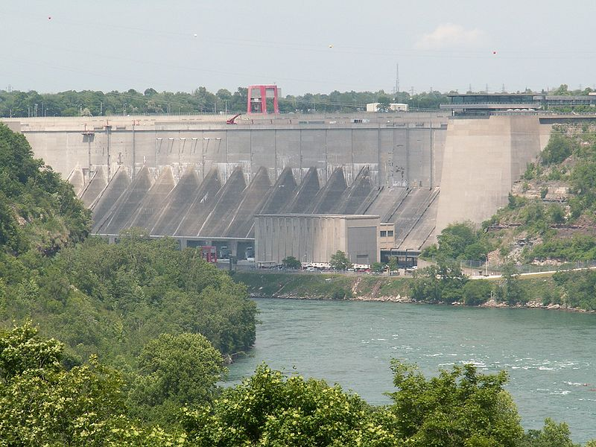
Niagara Falls Generating Station begins Operation
1896: Niagara Falls generating station began operation
Three 5,000 horsepower (3.7 MW each), 2 phase, 25 Hz, generators.
Transmitted power the 22 miles to Buffalo NY at 11,000 Volts
This system firmly established the dominance of AC systems over DC systems.
Since the power was transmitted via AC the distribution systems was also AC.

Slide 15
The Financial Framework of the Emerging Utility Industry
Early power companies faced many technical challenges.
Companies would have to build out their entire system before they could sell power, this made it difficult to finance the building of new systems.
Even with AC systems differences in frequency could require two parallel systems with one frequency for lighting and another for industrial loads. For example, 60 Hz for lighting loads and 25 Hz for industrial loads.
The utilization factor of generators was low, with some only running at night for lighting.
In order to sell power it was necessary to obtain a non-exclusive franchise from the local municipality.
The franchise system was operated at a municipal level and as such it was not uniform, and in many cases it was corrupt.
A franchise could be short term which increased the uncertainty of operation and made for a challenging financial environment.
The overall effect was that early power companies had a relatively low rate of return on large fixed investments.
Early utility leaders such as Samuel Insull proposed the regulation of the industry by state officials in order to develop a more stable business environment.

Slide 16
The Evolving Power System
Once the AC paradigm was set by the Niagara Falls generating station, AC systems were able to be interconnected with generation located far from the end-use load.
With an AC system it was possible for a single system to supply multiple voltages to customers.
While there was still a need for different frequencies, the number of frequencies began to decrease because of the desire to interconnect systems for increased efficiencies.
A single set of generators could be used to supply multiple distribution systems of different types.
By supplying loads that consumed power at different times, the utilization factor of the generators increased.
The increase in efficiency meant that there was an economic pressure to consolidate companies, which could be accomplished with AC systems.
With regulation still only occurring at the state level large non-regulated holding companies began to form.
The formation of large unregulated multi-state holding companies lead to a number of issues. Most prominent of these was the financial interactions between regulated utilities and their unregulated holding companies.
Following the many technical advances and financial structures that evolved, legislation and regulation followed to address these new conditions followed.

Slide 17
Significant Policy Milestones
1920: The Federal Water Power Act of 1920
Established the Federal Power Commission, now the Federal Energy Regulatory Commission (FERC)
Primary role was to license hydroelectric plants and to regulate interstate activities
1935: Public Utility Holding Company Act of 1935
Passed in response to the Great Depression
Holding companies to be regulated by the Security Exchange Commission (SEC)
In place until 2005.
1936: The Rural Electrification Act of 1936
Establish the Rural Electrification Administration (REA) (<2,500 people)
Preferred status for Federal power and loan guarantees
1933: Tennessee Valley Authority Act of 1933
Created the TVA
Ability to sign 20 year contracts
1937: The Bonneville Project Act of 1937
Formed the Bonneville Power Administration (BPA)
Markets power from the Bonneville Dam and to construct transmission facilities
1968: Formation of North American Electric Reliability Council (NERC)
Formed in response to the 1965 Northeast blackout as part of FPC report
1978: The Public Utility Regulatory Policies Act (PURPA)
Utilities were required to purchase power from independent power producers
Implementation was left with the individual states
2005: The Energy Policy Act of 2005
FERC, through NERC, has authority over reliability
This includes transmission as well as distribution companies

Slide 18
The Federal Water Power Act of 1920
As systems became more interconnected it was possible to reach distant generation sources such as hydroelectric resources.
The primary role of the Federal Water Power Act of 1920 was to license hydroelectric plants and reservoirs.
To oversee the licensing process the Federal Power Commission (FPC) was established.
The Water Power Act allowed for the coordination of hydroelectric activities across the country.
These hydroelectric resources powered many of the early distribution systems
Amended in 1935 to include regulation of all interstate transmission and sale of electric power, and changed the structure of the FPC to have 5 commissioners nominated by the President.
FPC was renamed in 1977 with the creation of Federal Energy Regulatory Commission (FERC)

Slide 19
Public Utility Holding Company Act of 1935
The Stock Market Crash of 1929 and the subsequent Great Depression caused a number of the holding companies to fail, including Samuel Insull’s.
By the early 1930’s a small number of large utility holding companies controlled approximately ¾ of the investor owned electric utility industry.
Regulation allowed utilities to recover a “fair” return on their rates. The unregulated holding companies would sell services to their regulated utilities at inflated rates which was effectively bypassing the existing state level regulation.
In response to the Great Depression and the perception of the utility holding companies the Public Utility Holding Company Act of 1935 was passed.
Holding companies were to be regulated by the Security Exchange Commission (SEC)
Prevented regulated utilities from engaging in unregulated activates, e.g. streetcars subsidiaries.
The Public Utility Holding Act was in place until it was replaced in the Energy Policy Act of 2005.

Slide 20
The Rural Electrification Act of 1936
Because of the population density of urban centers they were the first areas to see the deployment of distribution systems.
Companies that operated at a profit had no desire to supply electricity to low density rural areas.
In an unregulated environment there is no obligation of service, so there was no effective way for rural areas to obtain electricity.
The Rural Electrification Act of 1936 was designed to provide electricity to rural customers.
Established the Rural Electrification Administration (REA) with cooperatives for towns with less than 2,500 people.
Established a preferred status for Federal power.
Provided loan guarantees for rural cooperatives.
In 1934 10% of rural farms had electricity, that number increased to nearly 50% by 1942.
Cooperatives today (As of 2011):
841 Distribution companies and 65 Generation and Transmissions companies.
Deliver 10% of total Kwh and generate nearly 5% of total electricity.

Slide 21
Tennessee Valley Authority Act of 1933
Federally operated power systems were seen as one option to address the corrupt franchise system.
Federally operated power systems could also facilitate rural electrification.
The Tennessee Valley Authority Act of 1933 is passed.
This legislation was primarily passed for flood control and navigation, but it provides enormous electrical resources to the region.
Created the Tennessee Valley Authority (TVA) which is both a supplier of electricity and a regulatory agency with the ability to sign long term contracts (20 years).
The idea of a federally operated system was not universally accepted, and still has opponents.
The TVA today:
11 Coals plants, 11combustion turbines, 3 nuclear power plants, 29 hydroelectric facilities, and renewables.
Operates 15,900 miles of transmission lines.

Slide 22
The Bonneville Project Act of 1937
Signed into law in 1937 the Bonneville Project Act of 1937
Formed the Bonneville Power Administration (BPA).
Tasked with marketing power from the Bonneville Dam, and to construct transmission facilities.
Unlike the TVA the BPA does not produce electricity.
Markets power from 31 federal hydroelectric dams operated by the U.S. Army Corps. of Engineers and the Bureau of Reclamation.
Operates 15,000+ miles of transmission lines.

Slide 23
Formation of North American Electric Reliability Council (NERC)
On November 9th 1965 what should have been a simple protective action turned into the Northeastern Blackout of 1965.
Prior to 1965 it was widely believed that large scale interconnections could be designed and operated with limited, if any, high level coordination.
As a result of the post mortem analysis of the blackout, it was determined that a coordinating organization was necessary to oversee wide area issues.
The Electric Reliability Act of 1967 established the formation of the North American Electric Reliability Council (NREC) with ten regional reliability councils.
Develop common operating policies
Training practices
Restoration coordination

Slide 24
The Public Utility Regulatory Policies Act (PURPA)
By the latter half of the 20th century it was clear that power systems were a natural monopoly. Redundant infrastructure for the delivery of electric power was inefficient.
The generation of electric power is not a natural monopoly, but a company that operates the wires is going to give preference to their own generation.
As a result, existing operating companies could effectively keep out any new generators.
The Public Utility Regulatory Policies Act (PURPA) was passed in 1978 and required utilities to purchase power from any qualified producer. The specific implementation was left to the various states.
Enabled significant cogeneration from large commercial and industrial customers.
Enables interconnections for renewables, including at the distribution level.

Slide 25
The Energy Policy Act of 2005
The Energy Policy Act of 2005 was passed as an attempt to address the problems that had arisen due to deregulation, reduce infrastructure investment, and growing load.
The Energy Policy Act of 2005 contains numerous provisions, some of the more prominent are:
North American Electric Reliability Council is replaced by North American Electric Reliability Corporation.
National Interest Electric Transmission Corridors: Where the limitations of the exiting transmission system adversely affect American citizens, the DOE, through FERC, can permit a project director to exercise eminent domain to purchase necessary property.
Extends daylight savings time by 4 weeks: an attempt to reduce energy consumption.
All public electric utilities are required to provide net metering to customers who request it.
Sets federal reliability standards for the electricity grid. FERC has the authority to implement these standards and uses the newly formed NERC to execute; these rules apply to distribution as well as transmission operators. (Reliability Standard for the Bulk Electric System of North America)

Slide 26
Structure of Todays Distribution Companies
Vertically integrated utilities do not exist where interstate commerce is conducted.
Some distribution utilities own some of their own generation and operate their distribution systems at the same time, but they are divested from transmission.
Currently there are 4 distinct distribution company types:
Investor Owned Utility (IOU)
Municipally owned (MUN)
Public Utility District (PUD)
Rural Cooperative (REA)
Number of distribution utilities:
Approximately 2128 Distribution only
Approximately 453 Distribution with generation

Slide 27
Characteristics of Todays Distribution Systems
With the exception of traction power networks for trains, all North American distribution systems are 60 Hz. The last 25 Hz generation at Niagara Falls was retired in 1994.
4 wire Wye connected distribution systems are the most common.
There are some legacy Delta connected systems, but they are rare.
Urban networked cores can have multiple grounds, so are not 4 wire.
Multiple voltages are still used, but 12.47 kV is the most common. Other common voltages include: 4.2 kV, 13.2 kV, 13.8 kV, 24.9 kV 34.5 kV.
Other uncommon voltages include: 12.00 kV and 26.00 kV.

Slide 28
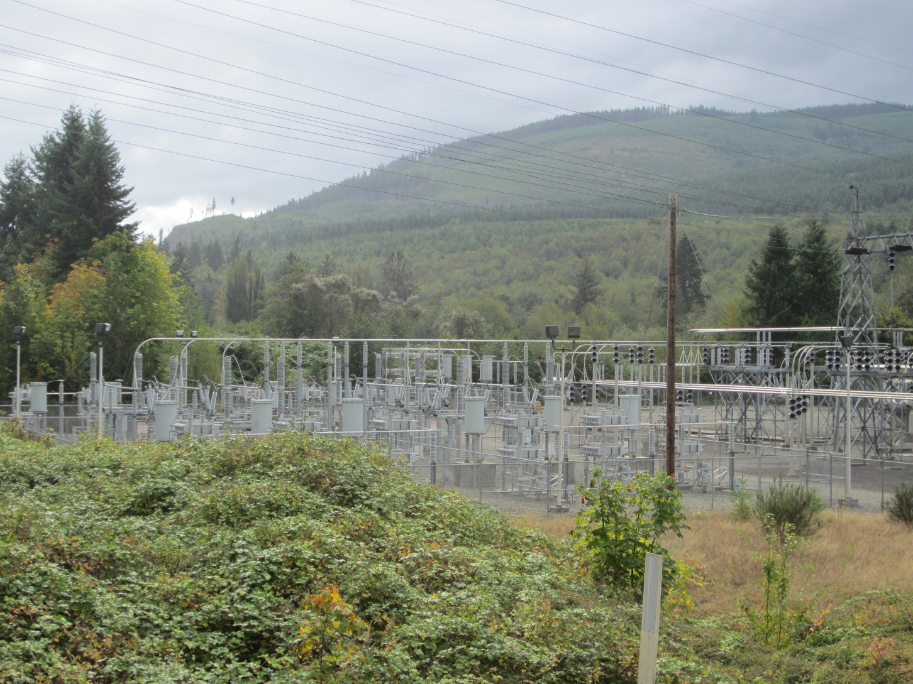
Part 2: Distribution System Design Characteristics

Slide 29
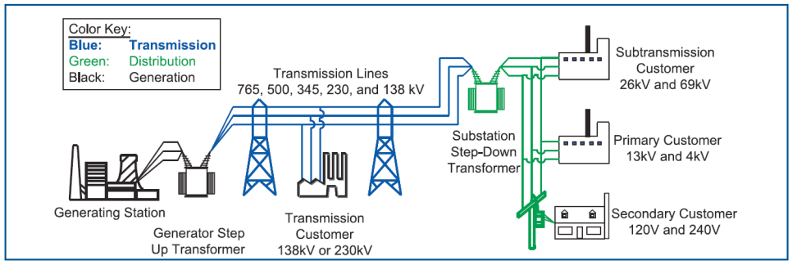
Elements of an Electrical Distribution System
Substations
Substation transformers
Measurement devices
Voltage control devices
Overhead lines
Underground cables
Breakers
Switches
Protective devices
Service transformers
Triplex cables
End-use loads
Distributed Generation (DG)
Supervisory Control And Data Acquisition (SCADA)
Distribution Management System (DMS)

Slide 30
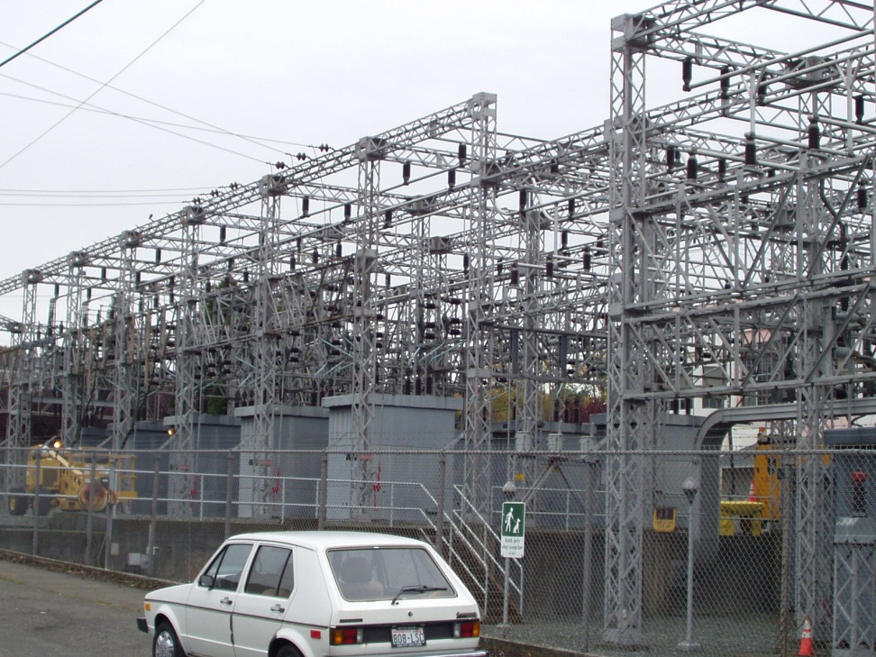
Substations

Slide 31
Substations
There are multiple types of substation:
Transmission
Switching
Combination
Distribution
Transmission: These substations connect power plants to the transmission lines that transfer the power to load centers. In addition to connecting the output of the power plant to the transmission system, sometimes they contain the necessary step up transformers for the generators.
Switching: These substations do not contain any generators or significant loads and do not change voltage levels, they are simply a station for switching multiple transmission or sub-transmission lines.
Combination: These substations will contain switching operations as well as providing for changes in voltage levels.
Distribution: These substation connect individual distribution feeders to the transmission or sub-transmission system. Additionally, they contain switching equipment so that feeders can be supplied from multiple sources.

Slide 32
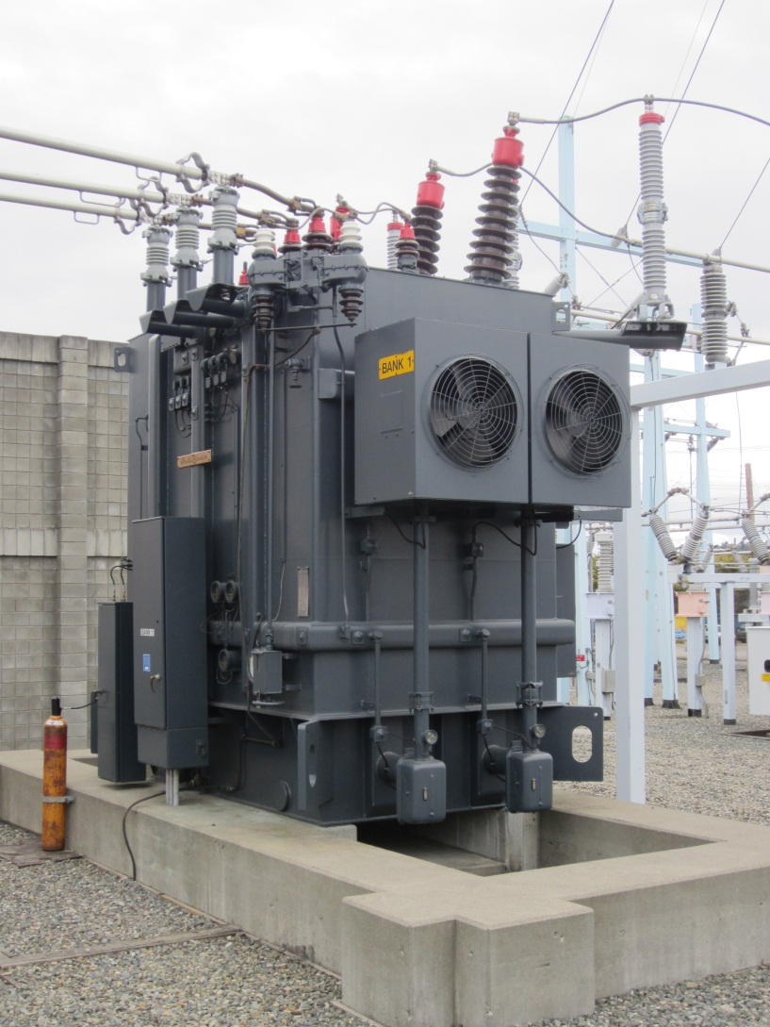
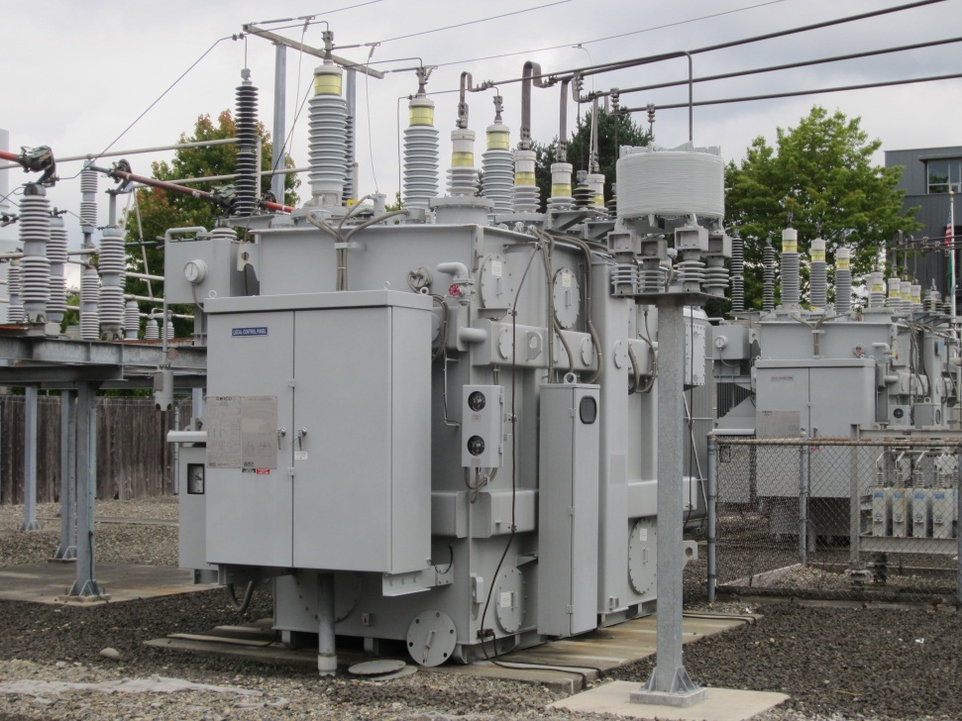
Substation Transformers

Slide 33
Substation Transformers
Substation transformers can perform various functions:
Step voltage up from generation to transmission levels.
Convert between voltages transmission lines.
Step voltage down for use at the distribution level.
Power ratings can be from a couple MVA at the distribution level to greater than 1,000 MVA at the transmission level.
These transformers are generally very efficient, greater than 98%.
Even with high efficiencies, thermal losses must be addressed.
Passive cooling.
Passive cooling with a radiator.
Forced air cooling with a radiator.
Spray cooling with a radiator.
Circulated oil cooling with a radiator.

Slide 34
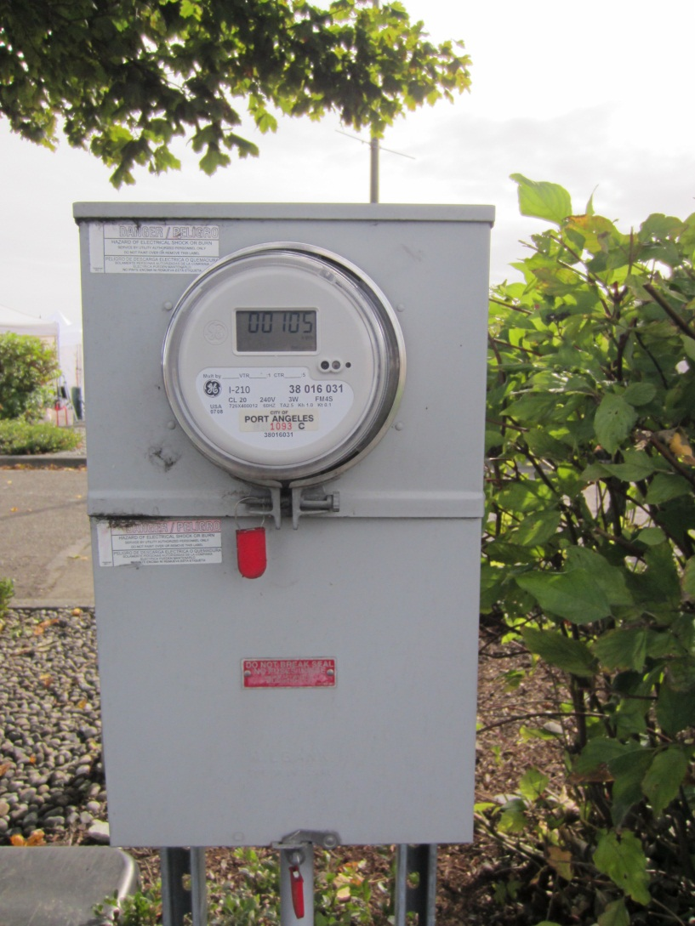
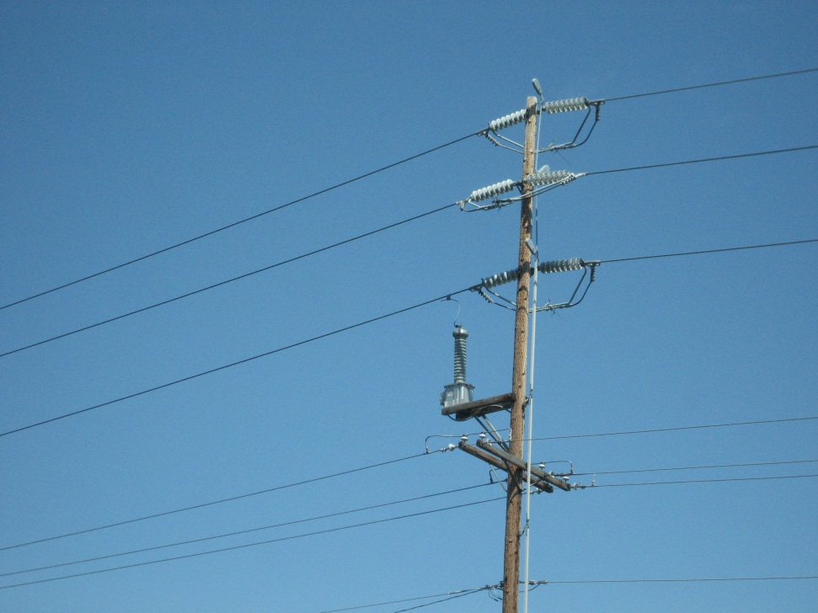
Measurement Devices

Slide 35
Measurement Devices
At the transmission level there are generally numerous measurement devices.
Voltage: static RMS value.
Current: static RMS value.
Power: Real and reactive power can be calculated using the voltage and current transducers.
PMUs: high speed time synchronized measurements that allow for the dynamics of a system to be examined.
At the distribution level there are significantly fewer measurement devices.
A distribution substation may have measurements for the sub-transmission side.
For a small rural substation there may be no measurements for the sub-transmission side.
The distribution side may have voltage and current, but nothing additional downstream.
The distribution side may have no measurements at all.
All end use customers are metered to determine how much power they consume.
Without effective metering of end use customers distribution system would not be viable.
Some systems operate with relatively few measurements between generation and the end use customer.

Slide 36
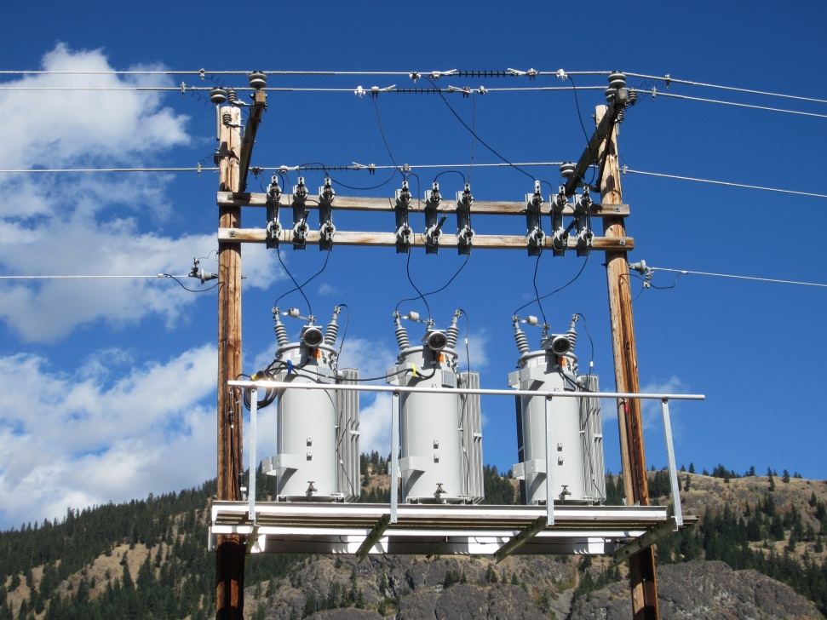
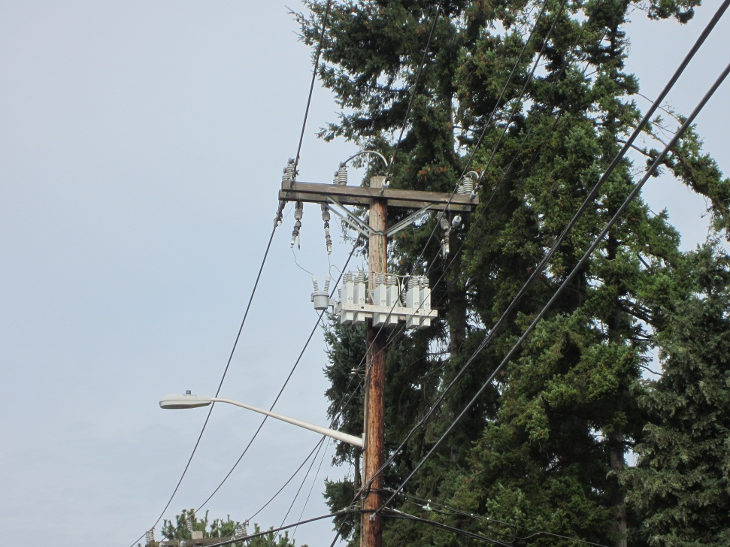
Voltage Control Devices

Slide 37
Voltage Control Devices
Voltage control at the transmission level is general achieved with central generation plants.
Large banks of capacitors are also used in some cases.
There are some tap changing transformers at the transmission level.
Voltage control at the distribution level is more difficult because of the lack of generation and the low level of observability.
Tap changers: variable tap transformers that can be integrated into the substation transformer, or operate as a separate unit. Voltage regulation of +/10% can be achieved.
Voltage regulators: autotransformers that allow for voltage regulation of +/10%.
Shunt capacitors: located at the substation or on the distribution feeder. They inject reactive power and reduce the apparent current in systems with lagging loads.
Distributed generation: under current IEEE-1547 standards distributed resources cannot regulate voltage. 1547.8 is near completion and will allow distributed resources to regulate voltage.

Slide 38
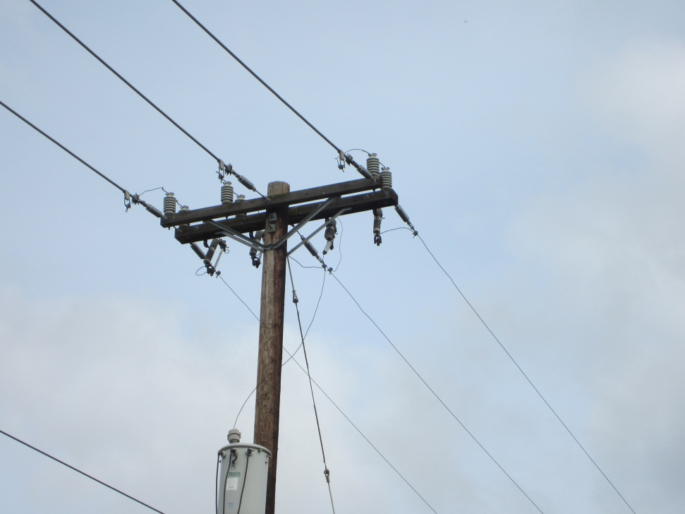
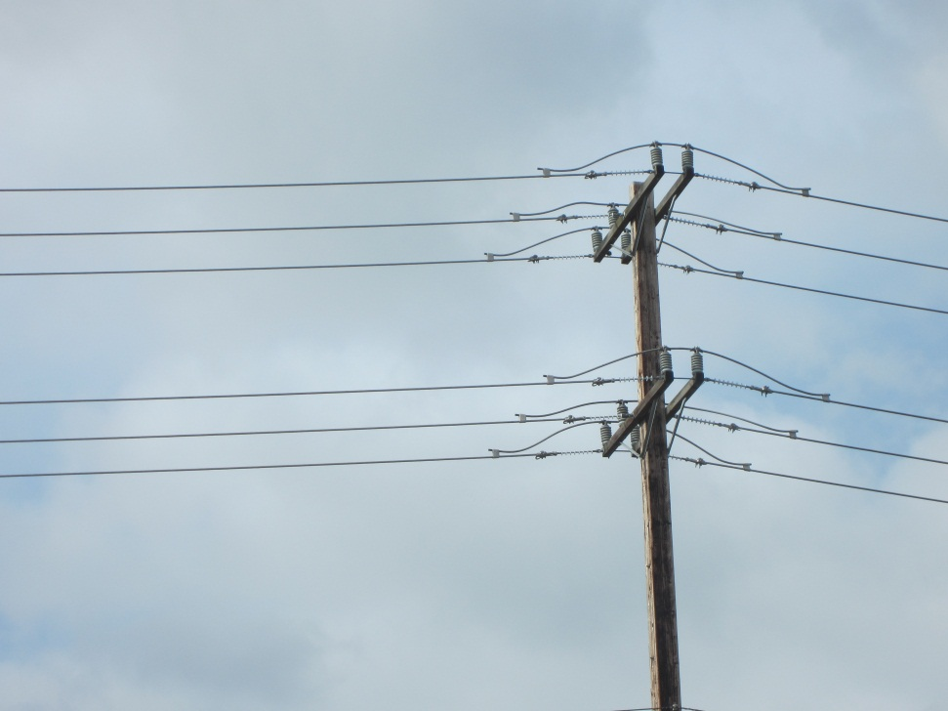
Overhead Lines

Slide 39
Overhead Lines
Overhead lines are the most common method of distributing electricity.
This is this most cost effective method of power distribution.
They are constructed with aluminum and steel, copper is generally not used because of its high cost.
Overhead lines are not insulated, they are bare conductors.
Because of their exposure, faults will occur when the conductor comes into contact with the ground, vegetation, animals, or people.

Slide 40
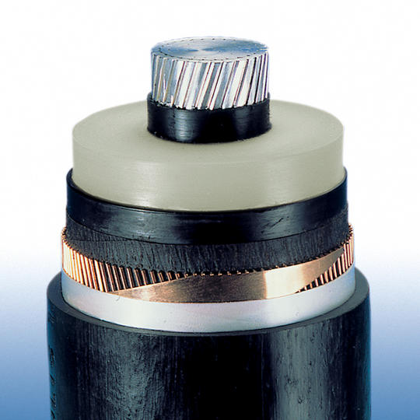
Underground Cables

Slide 41
Underground Cables
Underground cables may be used in a number of situations:
In areas where there are numerous momentary faults, e.g. wind storms.
In urban areas where overhead lines may not be practical or desirable.
In communities where there is a desire to not have visible infrastructure.
Cables can be directly buried or laid into conduit or a vault.
Underground cables have some desirable characteristics but they can be up to ten times the cost of overhead lines.
When faults do occur, it can be difficult to locate and fix the fault. It may be necessary to dig the cable up to fix the fault.

Slide 42
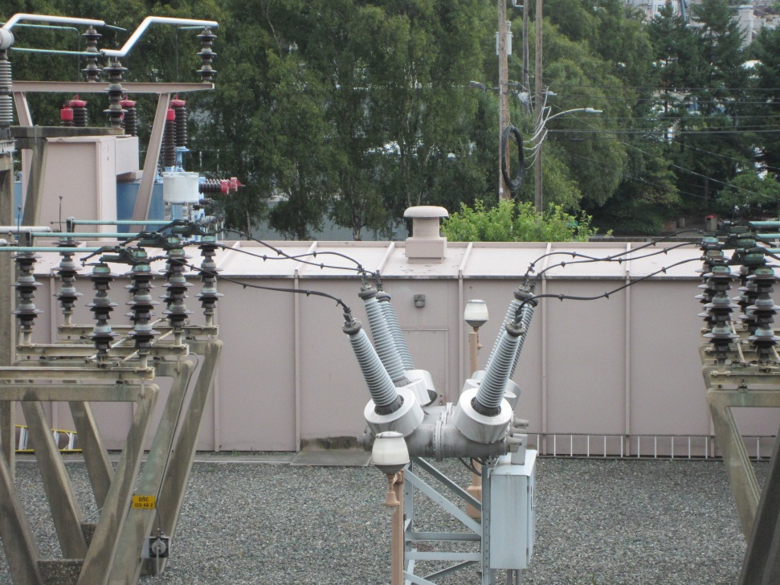
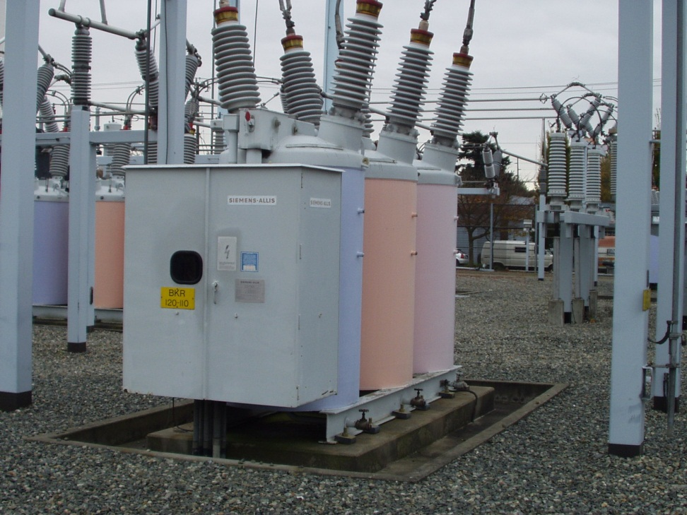
Breakers

Slide 43
Breakers
The primary function of a breaker is to provide for electrical isolation.
Breakers are designed to be able to interrupt fault current.
Breakers are only the current interruption device, other equipment is used to determine when a breaker should open.
In order to quench the arc when opening under load there are a number of mediums that are used:
Air: Common breaker type where the contacts are open to the air.
Oil: Common breaker type where the contacts are immersed in an oil.
Vacuum: Contacts are in a vacuum can.
SF6: Contacts are in a pressurized case filled with SF6.
Breakers are used at all levels in power systems.

Slide 44
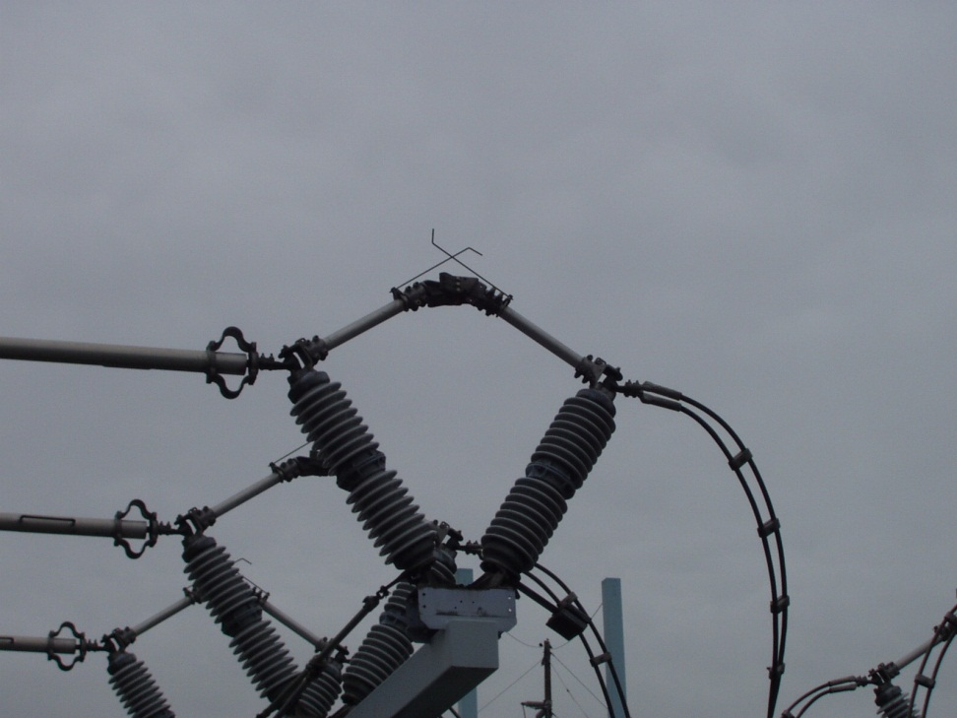
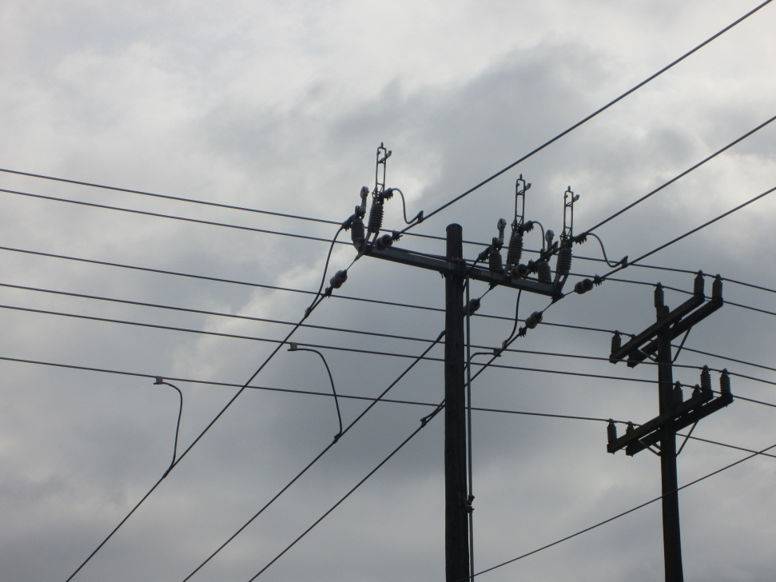
Switches

Slide 45
Switches
The primary function of a switch it to provide electrical isolation.
Switches are not protective devices, unlike breakers they cannot interrupt current.
Switches at a substation can transfer load between substation transformers.
At the distribution level switches are used to reconfigure a feeder.
Switches can be used to transfer load from one feeder to another.
Switches can also be used as part of a system repair strategy in order to isolate portions of the system while repairs are conducted.

Slide 46
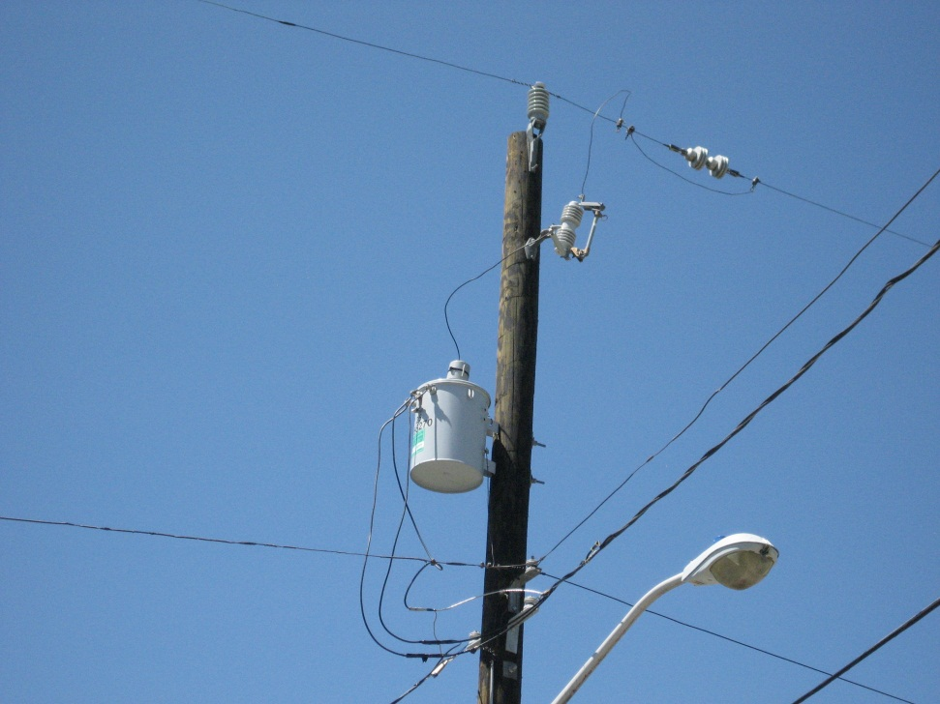
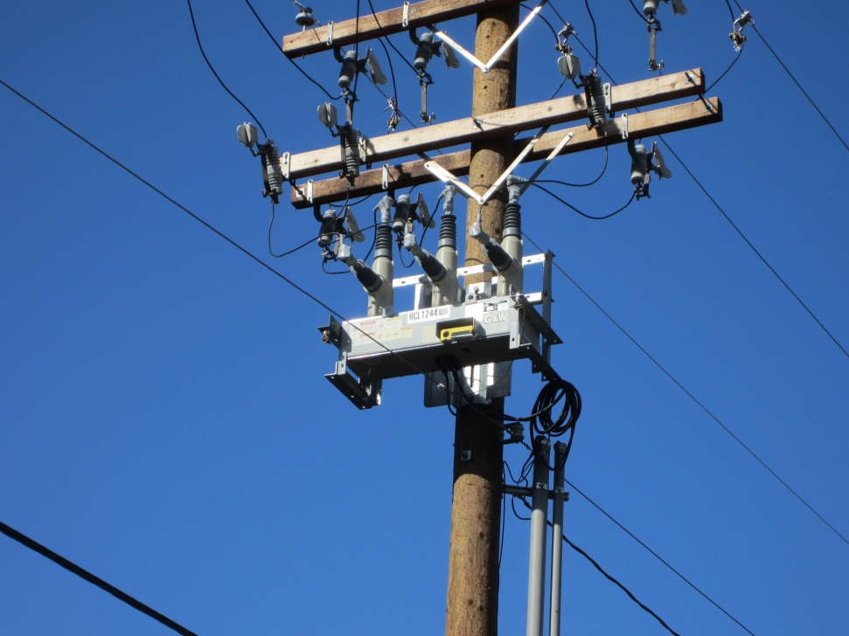
Protective Devices

Slide 47
Protective Devices
Under normal operating conditions power flows from the generators to the end use loads through closed circuits.
In reality these circuits can be interrupted by a number of events.
Fault causes:
Vegetation: trees that grow into power lines.
Storms: trees can be blown into power lines or ice can accumulate on lines and cause failure.
Animals: Animals sometimes cause short circuits.
People: Either by accident or direct intent.
When a fault occurs the current flowing through the system can increase significantly.
The primary purpose of protective devices is to prevent injury to people and damage to equipment.
Protective devices operate to interrupt fault currents in the system.
These devices can protect individual devices, or be designed to provide protection to multiple devices.

Slide 48
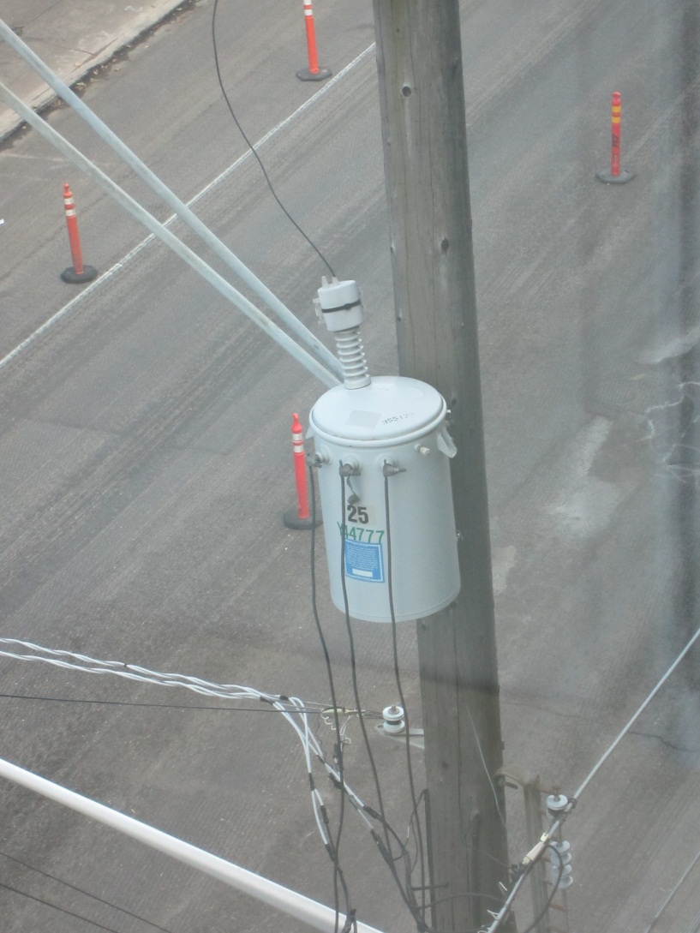
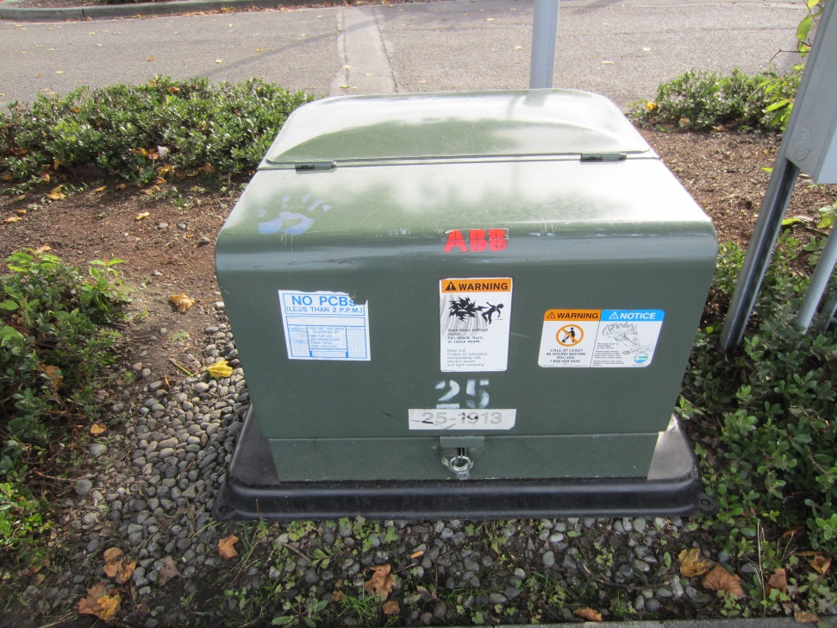
Service Transformers

Slide 49
Service Transformers
Service transformers are the device that lower the voltage from distribution levels to usable customer levels.
These transformers can be overhead, or pad mounted.
They can be single phase or three phase.
Single phase residential service transformers are center tapped so that 120V and 240V is available.
A single service transformer can serve multiple customers.

Slide 50
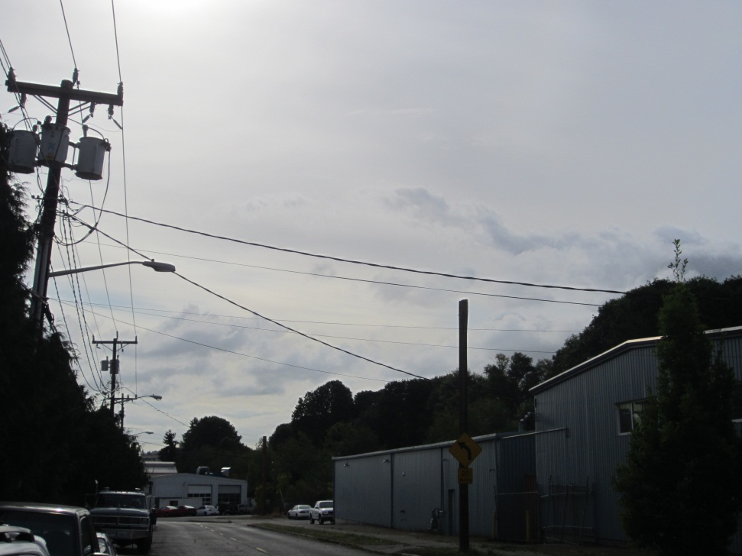
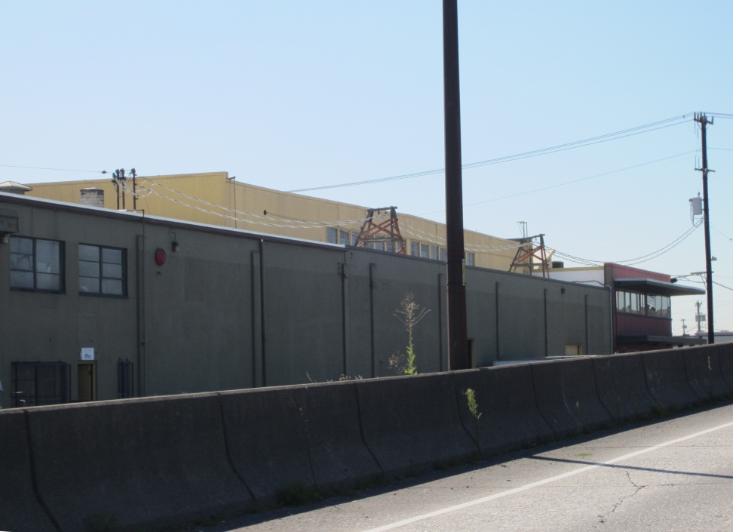
Triplex Cables

Slide 51
Triplex Cables
Triplex cables connect the service transformer to the end use customer.
Utilities generally have guidelines for how long these cables can be, but there are always exceptions.
Utilities have no indication of the voltage drop across these cables.
Multiple customers can be serviced from a single service transformer via independent triplex cables.

Slide 52
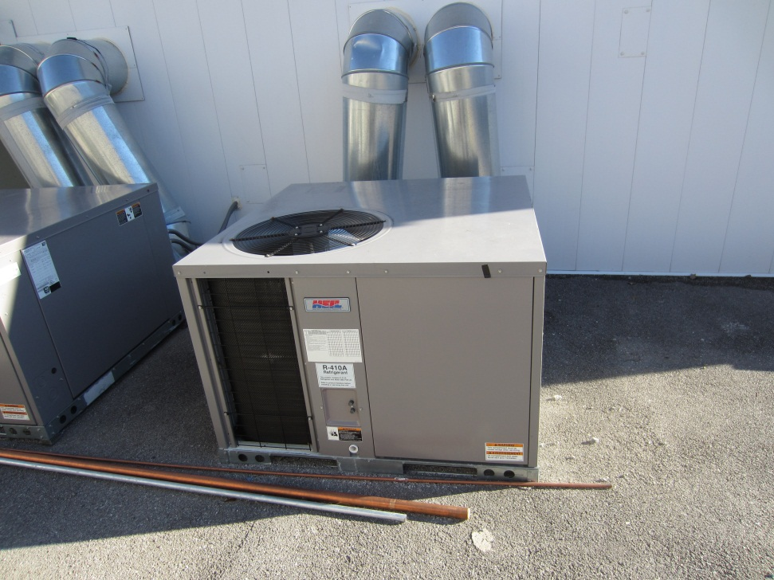
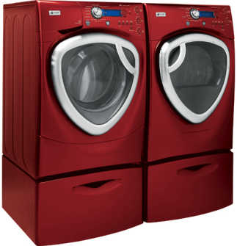
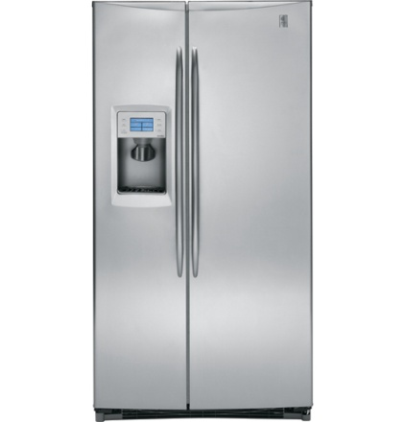
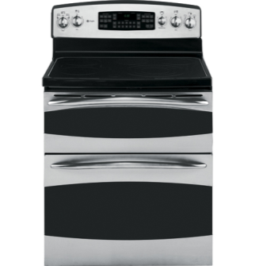
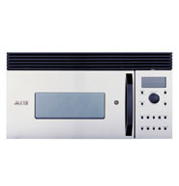
End-Use Loads

Slide 53
End Use Loads
End use loads are the equipment and devices that consume electric power and convert it into mechanical or thermal energy.
Residential Loads
Heating Ventilating and Air Conditioning (HVAC)
Lighting (Incandescent, fluorescent, and LED)
Entertainment (TV, computers, other electronics)
Household (Hot water heating, laundry, small pumps)
Commercial Loads
Heating Ventilating and Air Conditioning (HVAC)
Lighting (Incandescent, fluorescent, and LED)
Entertainment (TV, computers, other electronics)
Industrial Loads
Heating Ventilating and Air Conditioning (HVAC)
Lighting (Incandescent, fluorescent, and LED)
Heavy machinery (1,000 HP motors, traction motors, arc furnaces)
Agricultural Loads
Large pump motors for moving water (Variable frequency drives)

Slide 54
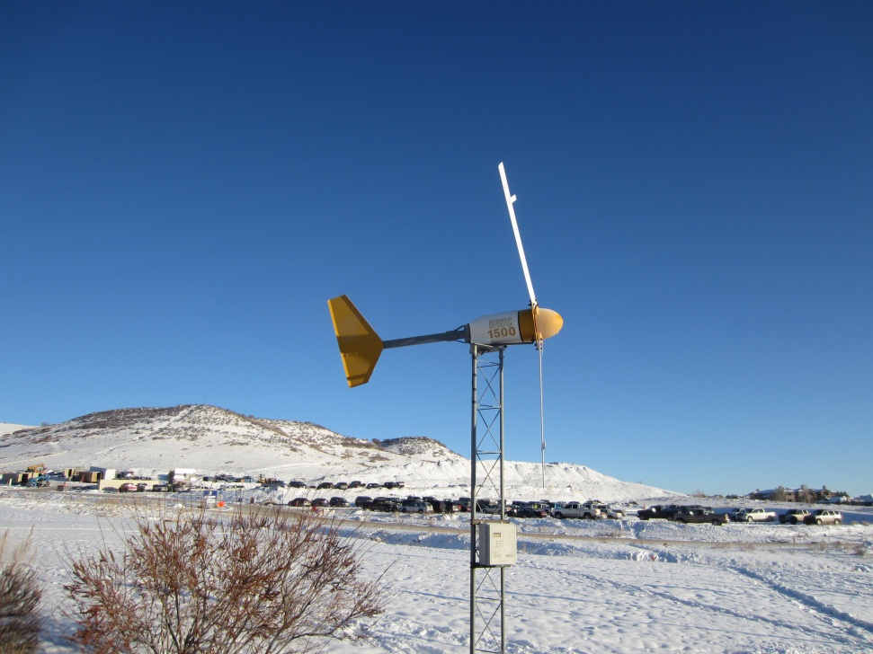
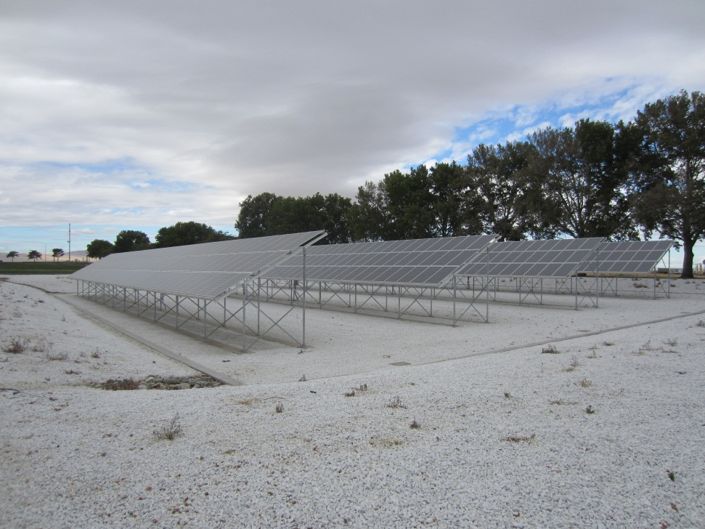
Distributed Generation

Slide 55
Distributed Generation
While economies of scale drove the nations infrastructure to large central generation plants, the 1978 PURPA act required utilities to purchase power from qualified providers.
With the continued adoption of renewable portfolio standards by individual states the amount of distributed generation is increasing.
Distributed generation can be provided by either traditional fossil fuels, or renewable resources.
Diesel generator, micro turbine
Wind, solar photo voltaic, micro hydro
Regardless of the source of primary energy, distributed generation operates on systems that were originally designed for unidirectional power flows.
Because the power is generated closer to the load there are fewer systems losses.

Slide 56
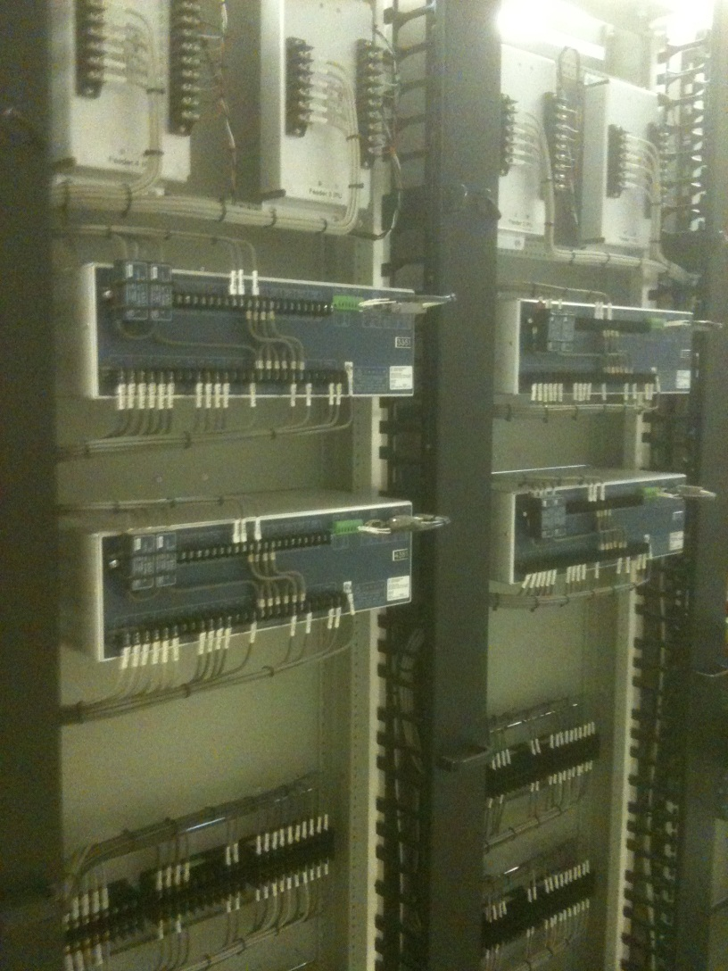
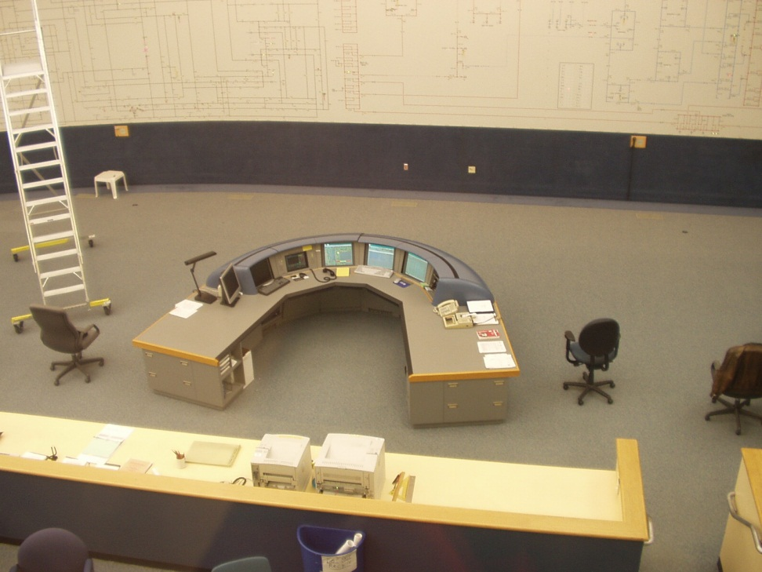
Supervisory Control And Data Acquisition

Slide 57
Supervisory Control And Data Acquisition
SCADA systems exist in many industries including petroleum and manufacturing.
SCADA is the system that allows for the collection of data and the execution of commands.
The following types of operations can be performed via SCADA:
Read the voltage at a substation.
Read the current on a distribution feeder.
Operate an automated switch.
There are multiple communications protocols that can be use for SCADA:
Modbus: legacy but still widely used
DNP3: Can operate over TCP/IP
IEC 61850: Can operate over TCP/IP
Cyber security is an issue with command and control system.

Slide 58
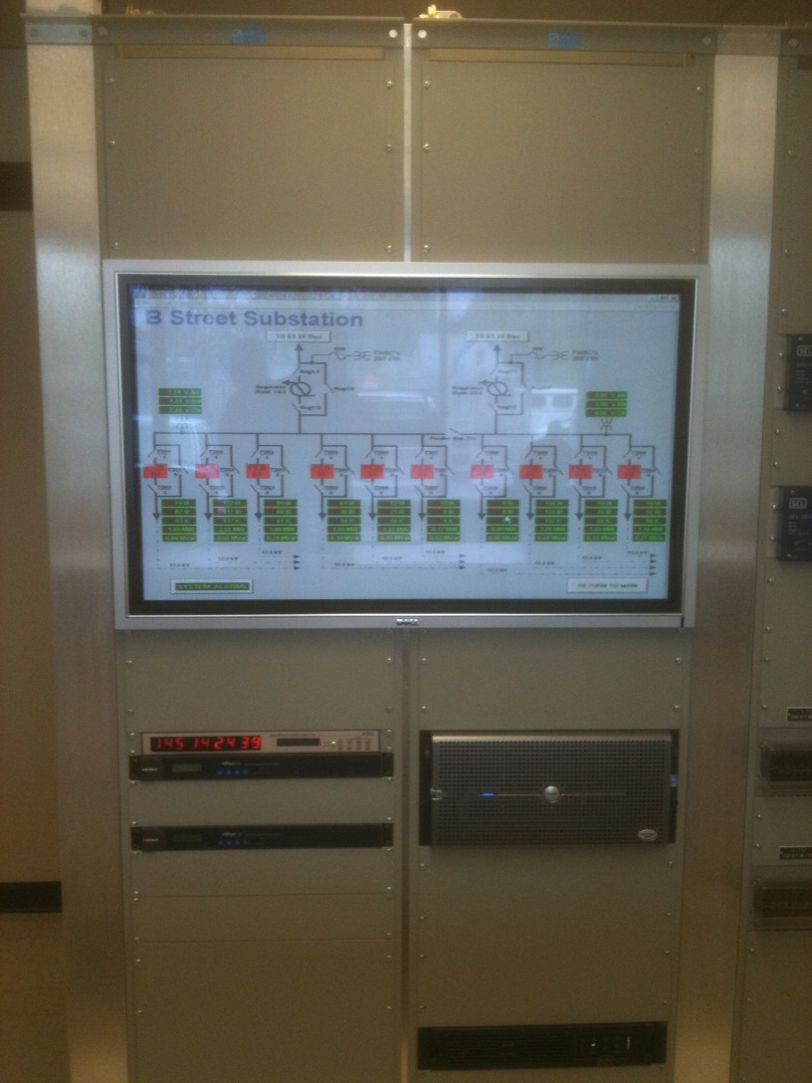
Distribution Management System

Slide 59
Distribution Management System
A DMS is a central control system for the coordinated operation of the distribution system.
Information and commands can be sent over a SCADA system, or other network.
While a SCADA system can send individual commands, a DMS can implement complex control strategies:
Automated Meter Infrastructure (AMI)
Outage Management Systems (OMS)
Fault Detection Identification and Restoration (FDIR)

Slide 60
Part 3: Operational and Planning Considerations
Historically, distribution utilities in the United States have been able to deliver reliable power at an affordable rate.
Operational considerations
Reliability
Voltage
Planning considerations
Reliability
Voltage
Capacity
Must have reliable power and make money…

Slide 61
Capacity
Capacity is the amount of power that can be delivered through a specific piece of equipment.
At the distribution level equipment is generally limited by thermal parameters.
Overhead lines: as the current flowing through an overhead line increases the conductor heats up causing it to sag. Persistent high current flows through a line can cause a sag that makes contact with vegetation.
Underground cables: high currents flowing through a cable will increase the temperature. Higher temperate degrade the insulation around the cable and can decrease its life time.
Transformers: Similar to underground cables, high temperatures degrade the insulation. Transformers can sustain short duration overloads but it reduces their effective useful life.

Slide 62
Voltage
Distribution utilities generally attempt to keep voltage within the ANSI C84.1 range.
Range A (normal steady-state):114V-126V (RMS)
Range B(emergency steady-state):107V-127V (RMS)
<3% voltage unbalance at the utility meter if polyphase
Since there are rarely measurements outside of the substation, it is common to operate in the high end of Range A to ensure the most distant point on the system is above the minimum.
For some systems voltage can be maintained without any voltage regulation equipment at the distribution level.

Slide 63
Reliability
Reliability at the distribution level is measured using IEEE-1366.
SAIDI: indicates the total duration of interruption for the average customers and is calculated by dividing the sum of the customer interruption durations by the total number of customers served
SAIFI: indicates how often the average customer experiences a sustained interruption and is calculated by dividing the sum of the total number of customers interrupted by the total number of customers served.
CAIDI: represents the average time required to restore service and is calculated by dividing the sum of the customer interruption durations by the total number of customers interrupted.
MAIFI: the average frequency of momentary interruptions and is calculated by dividing the sum of the total number of customer momentary interruptions by the total number of customers served.
IEEE-1366 contains other less commonly used metrics as well.
IEEE standards are not legally enforceable unless they are mandated by a body with legal regulatory authority.

Slide 64
Part 4: Simulation and Analysis
Simulation and analysis is conducted to support the operational and planning needs of the power system. It can be performed by a number of stake holders:
Utility or their subcontractor
Qualified power producer
3rd party service aggregator
End use customer
Peak load planning has been the industry standard.
Analysis conducted for the peak hour on the peak day of the year.
Seasonal variations are not considered.
Emerging technology requires more detailed simulation and analysis.

Slide 65
A Selection of Simulation Tools
Commercial – Transmission
PSLF (http://site.ge-energy.com/prod_serv/products/utility_software/en/ge_pslf/index.htm
PSS®E (http://www.energy.siemens.com/us/en/services/power-transmission-distribution/power-technologies-international/software-solutions/pss-e.htm
Commercial - Distribution
CYMDIST (http://www.cyme.com/software/cymdist/)
DEW (http://www.edd-us.com/About.html)
SYNERGEE® (http://www.gl-group.com/en/powergeneration/SynerGEE_Electric.php)
Windmil (http://milsoft.com/products/windmil)
Open Source
GridLAB-D (http://www.gridlabd.org/)
Open DSS (http://www.sourceforge.net)

Slide 66
Module 1 Concluding Comments
In this module we have seen how the modern power system evolved through a combination of technical, regulatory, and social forces.
From small municipal systems the current electrical infrastructure has grown into three distinct bulk power systems.
Generation is provided by numerous central plants that include coal, nuclear, hydro., natural gas, and renewables.
Distribution systems are operated as radial feeders that supply the end-use customers.
While the technology and tools have changed over time, and continue to change at an accelerated pace, the basic concept of power delivery has remained the same.
The net result is the electrical infrastructure the nation has today, a system that supplies reliable power at affordable rates to the entire continental United States.

Slide 67

Substation and Distribution Automation
Conclusion of Module 1: Introduction and Evolution of Electric Distribution Systems

